Slide 1

Theoretical Improvements in Algorithmic Efficiency for Network Flow Problems
JACK EDMONDS & RICHARD M. KARP in 1972
Professor: Doctor I-Lin Wang
Student: Yi-Cheng Ke
Notes:
Professor and fellow classmates, hello. Today I will present on "Theoretical Improvements in Algorithmic Efficiency for Network Flow Problems" written by Jack Edmonds and Richard M. Karp in 1972. I have been assigned the section on Min cost flow.

Slide 2
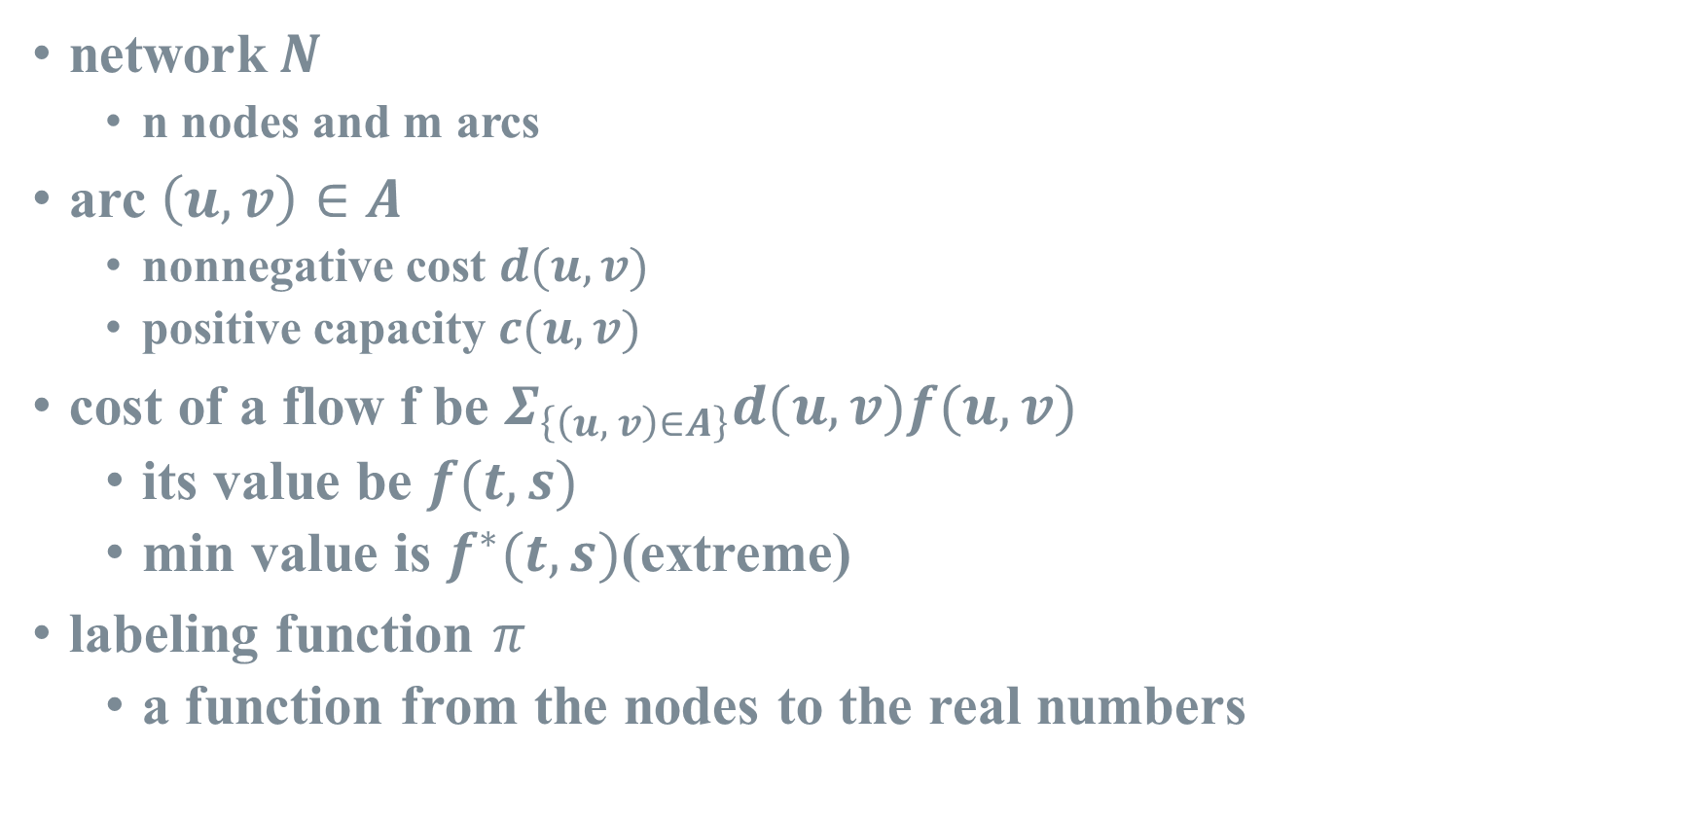
Notation(1/2)
network$N$
n nodes and m arcs
arc $\left(u, v\right)∈A$
nonnegative cost $d(u, v)$
positive capacity $c(u, v)$
cost of a flow f be $Σ_{\left\{\left(u, v\right)∈A\right\}}d(u, v)f(u, v)$
its value be $f(t, s)$
min value is $f^{∗}(t, s)$(extreme)
labeling function $π$
a function from the nodes to the real numbers
Notes:
First, let me introduce the notation used in my presentation. We use uppercase N to denote the entire network, with lowercase n representing the number of nodes and lowercase m representing the number of arcs. The set of all arcs is denoted by uppercase A. Each arc (u, v) has a cost denoted by d(u, v) and a capacity denoted by c(u, v), and the flow on that arc is denoted by f(u, v). Therefore, the total cost is the sum of the cost of each arc multiplied by its flow, and the total flow cost is denoted by f*(t, s) if it is the minimum cost. We use π as a label function which is similer to reduce cost.

Slide 3
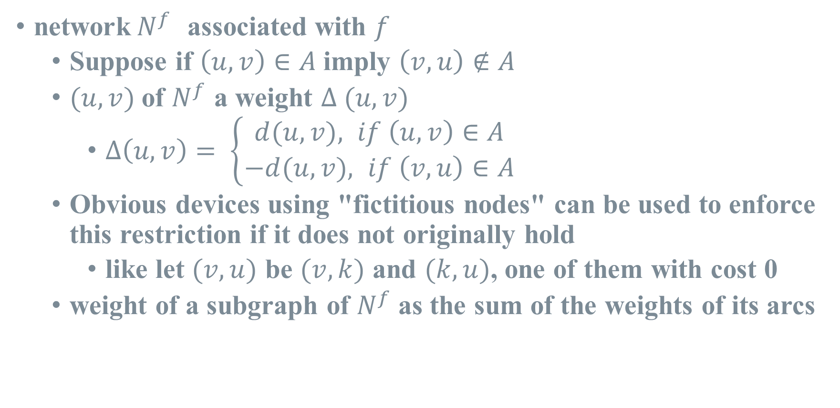
Notation(2/2)
network$N^{f}$ associated with $f$
Suppose if $\left(u, v\right)∈A$ imply $\left(v, u\right)∉A$
$(u, v)$of $N^{f}$ a weight $Δ (u, v)$
$Δ\left(u, v\right)= \left\{\begin{aligned}d(u, v), if \left(u, v\right)∈A \\ −d(u, v), if \left(v, u\right)∈A\end{aligned}\right.$
Obvious devices using "fictitious nodes" can be used to enforce this restriction if it does not originally hold
like let $(v, u)$ be $(v, k)$ and $(k, u)$, one of them with cost 0
weight of a subgraph of $N^{f}$as the sum of the weights of its arcs
Notes:
After a flow f is passed through the network, the resulting residual network is denoted by N^f. If (u, v) belongs to the set A, we set the cost of that arc as Δ(u, v) = d(u, v); otherwise, we set it as Δ(u, v) = -d(u, v). Additionally, we assume that in the original network N, there are no arcs (u, v) and (v, u) simultaneously. If such a situation occurs, we can introduce a new node k to resolve it.

Slide 4
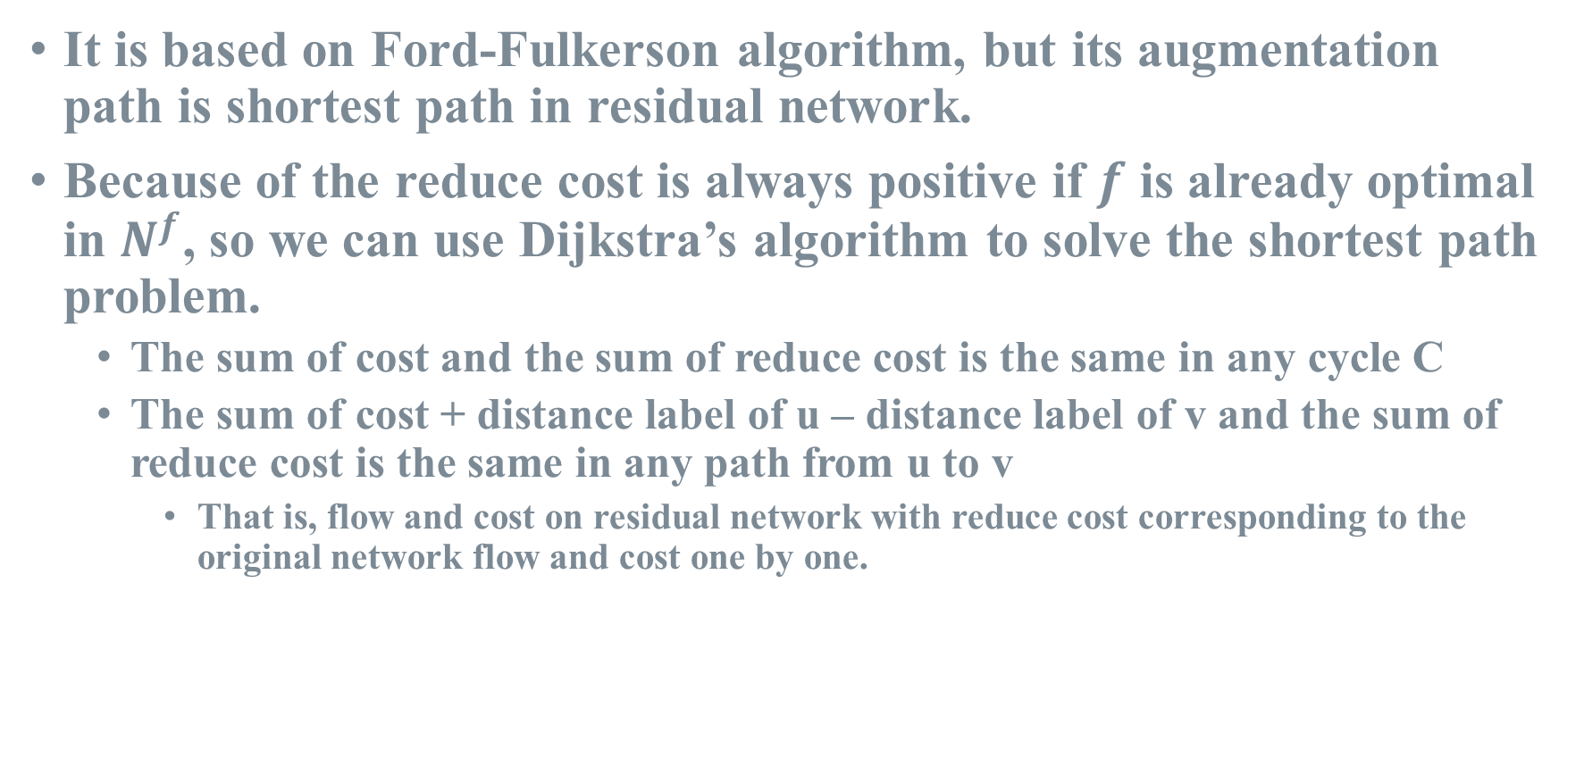
Idea of Labeling Method
It is based on Ford-Fulkerson algorithm, but its augmentation path is shortest path in residual network.
Because of the reduce cost is always positive if $f$ is already optimal in $N^{f}$, so we can use Dijkstra’s algorithm to solve the shortest path problem.
The sum of cost and the sum of reduce cost is the same in any cycle C
The sum of cost + distance label of u – distance label of v and the sum of reduce cost is the same in any path from u to v
That is, flow and cost on residual network with reduce cost corresponding to the original network flow and cost one by one.
Notes:
The paper consists of three parts mainly discussing two algorithms. The first one is the Labeling Method, which is based on the Ford-Fulkerson algorithm. The Ford-Fulkerson algorithm does not specify how to find the augmentation path, but the Labeling Method requires that the augmentation path must be the shortest path in the residual network. Since the reduced cost is positive, we can directly use Dijkstra's algorithm. Moreover, since the reduced costs of cycles and paths can be corresponded to the original network like this, this approach is effective.

Slide 5
Labeling Method
1
5
(4,10)
-2
2
(7,30)
3
23
(2,20)
(5,25)
(1,20)
4
(6,20)
-7
(2,25)
-19
5
Notes:
Here is an explanatory example with numerical values representing costs and capacities on arcs, and supplies or demands on nodes.

Slide 6
Labeling Method
1
7
8
5
(4,10)
-2
2
(7,30)
0
3
23
(2,20)
(5,25)
(1,20)
4
(6,20)
-7
(2,25)
-19
5
6
8
Notes:
The Labeling Method starts by performing Dijkstra's algorithm from any supply node.

Slide 7
Labeling Method
1
7
8
5
(4,10) → 3
-2
2
(6,20) → 0
0
3
23
(2,20) → 0
(5,25) → 6
(1,20) → 1
4
(6,20) → 0
-7
(2,25) → 0
-19
5
6
8
Notes:
We calculates the reduce cost for each arc, which is π(u) + d(u, v) - π(v).

Slide 8
Labeling Method
1
7
8
5
(4,10) → 3
-2
2
(6,20) → 0
0
3
23
(2,20) → 0
(5,25) → 6
(1,20) → 1
4
(6,20) → 0
-7
(2,25) → 0
-19
5
6
8
Notes:
We know that the arcs with reduce cost equal to 0 are on the shortest path. Thus, we obtain the following network.

Slide 9
Labeling Method
1
7
8
5
(4,10) → 3
-2
2
(6,20) → 0
0
3
16
(2,20) → 0
(5,25) → 6
(1,20) → 1
4
(6,13) → 0
(-6,7) → 0
0
(2,25) → 0
-19
5
6
8
Notes:
Next, we begin sending the flow. In this example, I start from the top-left and send the flow to the farthest node. After sending, a new arc (v, u) with cost -d(u, v) is added.

Slide 10
Labeling Method
1
7
8
5
(4,10) → 3
0
2
(6,20) → 0
0
3
14
(2,18) → 0
(5,25) → 6
(1,20) → 1
(-2,2) → 0
4
(6,11) → 0
(-6,9) → 0
0
(2,25) → 0
-19
5
6
8
Notes:
Then, we continue sending the flow, this time to the top-right. The minimum value among Supply 16, arc capacities on the path (13, 20), and Demand 2 is 2, so we send two units.

Slide 11
Labeling Method
1
7
8
5
(4,10) → 3
0
2
(6,20) → 0
0
3
3
(2,18) → 0
(5,25) → 6
(1,20) → 1
(-2,2) → 0
4
(-6,20) → 0
0
(2,14) → 0
-8
5
(-2,11) → 0
6
8
Notes:
We continue sending the flow, this time to the bottom-right. The minimum value among Supply 14, arc capacities on the path (11, 25), and Demand 19 is 2, so we send two units. After this, we can observe that this arc is saturated, indicating a change in the next shortest path.

Slide 12
Labeling Method
1
7
11
5
(4,10) → 0
0
2
(6,20) → 0
0
3
3
(2,18) → 1
(5,25) → 3
(1,20) → 1
(-2,2) → 0
4
(-6,20) → 3
0
(2,14) → 0
-8
5
(-2,11) → 0
9
11
Notes:
After re-executing the shortest path algorithm, we recalculate the shortest path by adding the reduce costs of the new path. Therefore, the value of π for the top-right node changes from 8 to 11, as the sum of the reduce costs on the shortest path is 3. I send to the nearest node again, and this time the arc is saturated. The minimum value among Supply 3, arc capacities on the path (20, 10, 2), and Demand 8 is 2, so we send two units.

Slide 13
Labeling Method
1
7
11
5
(4,8) → 0
0
2
(-4,2) → 0
(6,18) → 0
0
(-6,2) → 0
3
1
(2,20) → 1
(5,25) → 3
(1,20) → 1
4
(-6,20) → 3
0
(2,12) → 0
-6
5
(-2,13) → 0
9
11
Notes:
At this point, it becomes evident that this arc is saturated. Therefore, we need to re-execute the shortest path algorithm.

Slide 14
Labeling Method
1
7
11
5
(4,8) → 0
0
2
(-4,2) → 0
(6,18) → 0
0
(-6,2) → 0
3
1
(2,20) → 1
(5,25) → 2
(1,20) → 0
4
(-6,20) → 4
0
(2,12) → 0
-6
5
(-2,13) → 0
10
12
Notes:
Now, we have a new shortest path. Since the reduce cost of this arc is 1 and the others are 0, both nodes' π values are increased by 1. Then, we use the same method to send the remaining one unit.

Slide 15
Labeling Method
1
7
11
5
(4,7) → 0
0
2
(-4,3) → 0
(6,17) → 0
0
(-6,3) → 0
3
0
(2,20) → 1
(-1,1) → 0
(5,25) → 2
(1,19) → 0
4
(-6,20) → 4
0
(2,12) → 0
-5
5
(-2,13) → 0
10
12
Notes:
Next, we execute the shortest path problem starting from another supply node. In this case, the result is the same. Then, we use the same method to send the flow, and we can send 5 units.

Slide 16
Labeling Method
1
7
11
0
(4,2) → 0
0
2
(-4,8) → 0
(6,17) → 0
0
(-6,3) → 0
3
0
(2,20) → 1
(-1,6) → 0
(5,25) → 2
(1,14) → 0
4
(-6,20) → 4
0
(2,12) → 0
0
5
(-2,13) → 0
10
12
Notes:
At this point, all the supplies and demands are satisfied without violating the constraints of the dual problem, so the solution is optimal.

Slide 17
Labeling Method
1
7
11
5
(4,8) → 0
-2
2
3 → 0
0
3
23
0 → 1
0 → 2
6 → 0
4
20 → -4
-7
13 → 0
-19
5
10
12
Notes:
Organizing the total flow yields the following. We can observe that none of these three arcs are on the final shortest path; that is, they are either upper bounds or lower bounds. The reduce cost of the first arc is negative, indicating an upper bound, while the reduce costs of the other two arcs are positive, indicating lower bounds, i.e., 0.

Slide 18
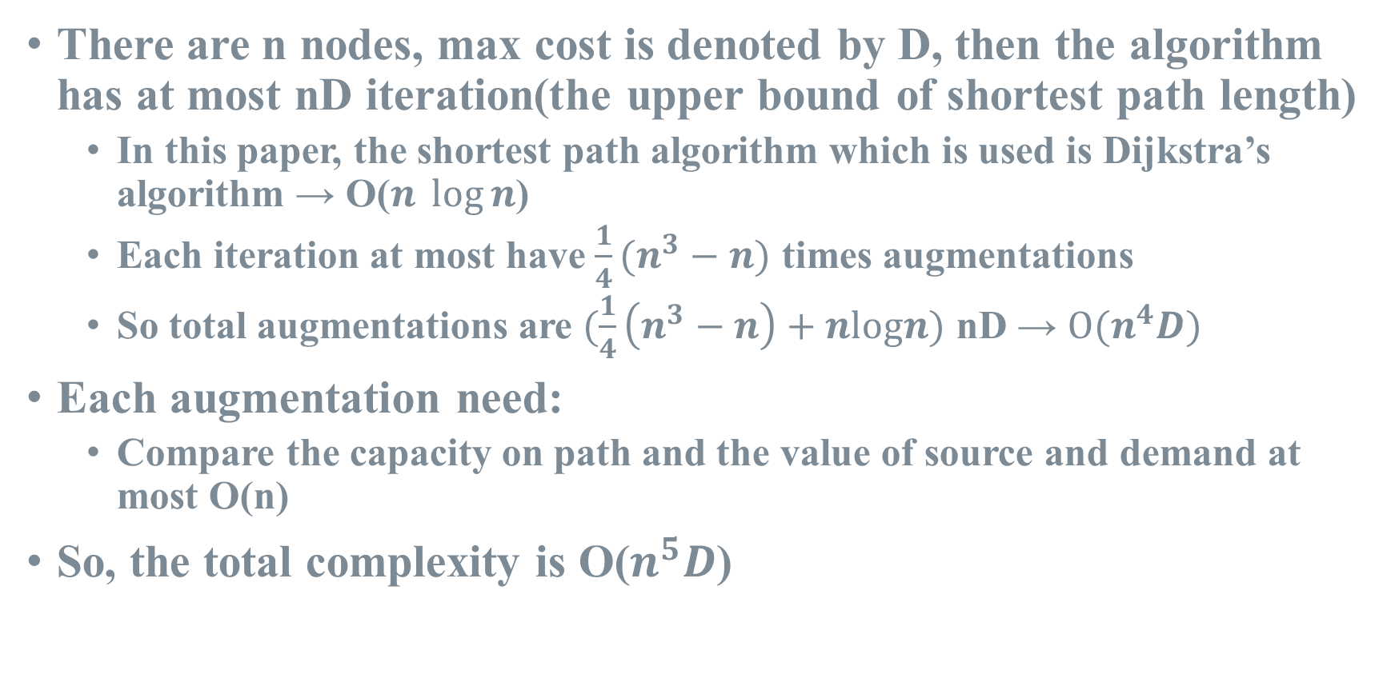
Complexity of Labeling Method
There are n nodes, max cost is denoted by D, then the algorithm has at most nD iteration(the upper bound of shortest path length)
In this paper, the shortest path algorithm which is used is Dijkstra’s algorithm → O($n \log{n}$)
Each iteration at most have $\frac{1}{4}(n^{3}−n)$ times augmentations
So total augmentations are $(\frac{1}{4}\left(n^{3}−n\right)+nlogn)$ nD → $O(n^{4}D)$
Each augmentation need:
Compare the capacity on path and the value of source and demand at most O(n)
So, the total complexity is O($n^{5}D$)
Notes:
Now, let's discuss the complexity. If we assume the cost is an integer, the number of possible shortest paths is at most nD. Thus, the shortest path algorithm is executed at most nD times. According to the paper's content in the max flow part, each iteration has at most 1/4(n^3 - n) times of augmentations. Therefore, the total time complexity should be O(n to the fourth power D). Each flow push requires O(n) to find the amount of flow to be pushed, resulting in a total complexity of O(n to the fifth power D). The calculation part at the end is my own deduction; it is not explicitly described in the paper.

Slide 19
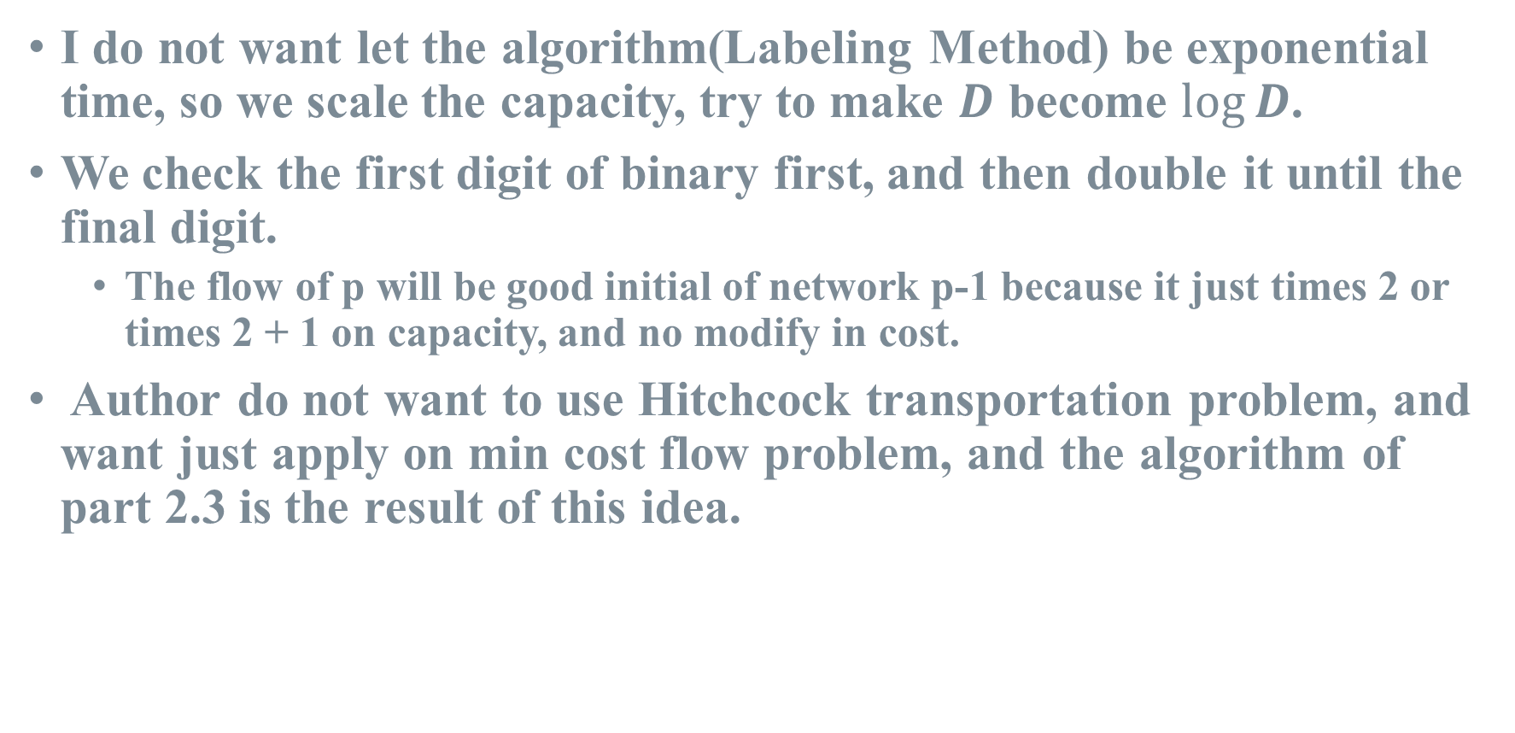
Idea of Scaling Method
I do not want let the algorithm(Labeling Method) be exponential time, so we scale the capacity, try to make $D$ become $log⁡D$.
We check the first digit of binary first, and then double it until the final digit.
The flow of p will be good initial of network p-1 because it just times 2 or times 2 + 1 on capacity, and no modify in cost.
Author do not want to use Hitchcock transportation problem, and want just apply on min cost flow problem, and the algorithm of part 2.3 is the result of this idea.
Notes:
After discussing the Labeling Method, the paper proceeds to the Scaling Method. However, before diving into that, I will discuss section 2.3 of the paper. In the Scaling Method, the goal is to transform the parameter D into log D. To achieve this, the authors convert all D values into binary form, starting from the most significant bit. It should be noted that while this transformation allows for solving other problems, the authors prefer to focus on the original problem.

Slide 20
Scaling Method
1
5
(4,10)
-2
2
(7,30)
3
23
(2,20)
(5,25)
(1,20)
4
(6,20)
-7
(2,25)
-19
5
Notes:
Let's consider an example network with the same structure as in the Labeling Method. The maximum capacity in the network is 30. Since the maximum capacity is 30, we start with p equal to 4, which is the smallest power of 2 greater than the maximum capacity minus 1.

Slide 21
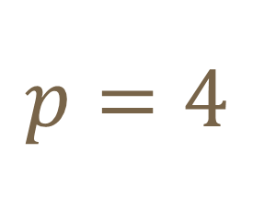
Scaling Method
$$p=4$$
1
0
(4,0)
0
2
(7,1)
3
1
(2,1)
(5,1)
(1,1)
4
(6,1)
0
(2,1)
-1
5
Notes:
We divide each capacity, supply, and demand by 2 raised to the power of p and take the floor value. As a result, we can see that the capacity of this arc becomes 0, so we won't consider this arc in the subgraph steps.

Slide 22
Scaling Method
$$p=4$$
1
7
8
0
(4,0)
0
2
(7,1) → 0
0
3
1
(2,1) → 0
(5,1) → 6
(1,1) → 1
4
(6,1) → 0
0
(2,1) → 0
-1
5
6
8
Notes:
Next, we perform Dijkstra's algorithm and calculate the reduce cost.

Slide 23
Scaling Method
$$p=4$$
1
7
8
0
(4,0)
0
2
(7,1) → 0
0
3
1
(2,1) → 0
(5,1) → 6
(1,1) → 1
4
(6,1) → 0
0
(2,1) → 0
-1
5
6
8
Notes:
Then, we start sending flow based on the shortest path.

Slide 24
Scaling Method
$$p=4$$
1
7
8
0
(4,0)
0
2
(7,1) → 0
0
3
0
(2,1) → 0
(5,1) → 6
(1,1) → 1
4
(6,1) → 0
0
(2,1) → 0
0
5
6
8
Notes:
By following the steps, we achieve supply-demand balance.

Slide 25
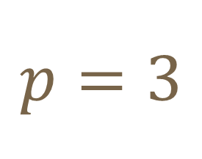
Scaling Method
$$p=3$$
1
7
8
0
(4,1)
0
2
(7,3) → 0
0
3
0
(2,2) → 0
(5,3) → 6
(1,2) → 1
4
(6,2) → 0
0
(2,1) → 0
0
5
(2,2) → 0
6
8
Notes:
Next, we set p to 3 and f to 2f. We recalculate the capacities and obtain a new network. We calculate the shortest path again, and now the supply-demand balance is achieved. In practice, there are additional checks required, but since they are not present in this example, I won't discuss them here.

Slide 26
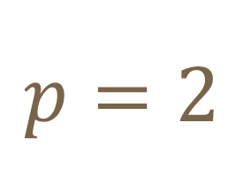
Scaling Method
$$p=2$$
1
7
8
1
(4,2)
0
2
(7,7) → 0, 0
0
3
1
(2,5) → 0, 0
(5,6) → 6, 0
(1,5) → 1, 0
4
(6,4) → 0, 0
(6,1) → 0
-1
(2,2) → 0, 0
0
5
(2,4) → 0
6
8
Notes:
We repeat the process by setting p to 2 and f to 2f. Again, we recalculate the capacities, calculate the shortest path, and start sending flow based on the shortest path.

Slide 27
Scaling Method
$$p=2$$
1
7
8
1
(4,2)
0
2
(7,7) → 0, 0
0
3
0
(2,5) → 0, 0
(5,6) → 6, 0
(1,5) → 1, 0
4
(6,5) → 0, 0
-0
(2,2) → 0, 0
0
5
(2,4) → 0
6
8
Notes:
And push the flow again. At this point, all demands are fulfilled, so we move on to the next stage.

Slide 28
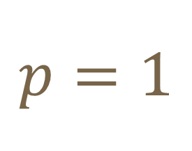
Scaling Method
$$p=1$$
1
7
11
2
(4,5) → 0, 0
-1
2
(7,15) → 0, 0
0
3
1
(2,10) → 0, 0
(5,12) → 6, 0
(1,10) → 0, 0
4
(6,10) → 0, 0
-1
(2,4) → 0, 0
-1
5
(2,8) → 0
12
12
Notes:
Setting p to 1 and f to 2f, we recalculate the capacities, obtain a new network, calculate the shortest path, and start sending flow based on the shortest path.

Slide 29
Scaling Method
$$p=1$$
1
7
11
2
(4,4) → 0, 0
0
2
(4,1) → 0, 0
(7,14) → 0, 0
0
(7,1) → 0, 0
3
0
(2,10) → 0, 0
(5,12) → 6, 0
(1,10) → 0, 0
4
(6,10) → 0, 0
-1
(2,4) → 0, 0
-1
5
(2,8) → 0
12
12
Notes:
The same process is repeated. We push the flow.

Slide 30
Scaling Method
$$p=1$$
1
7
11
1
(4,3) → 0, 0
0
2
(4,2) → 0, 0
(7,14) → 0, 0
0
(7,1) → 0, 0
3
0
(2,10) → 0, 0
(5,12) → 6, 0
(1,9) → 0, 0
(1,1) → 0, 0
4
(6,10) → 0, 0
-1
(2,4) → 0, 0
0
5
(2,8) → 0
12
12
Notes:
And push the flow again.

Slide 31
Scaling Method
$$p=1$$
1
7
11
0
(4,2) → 0, 0
0
2
(4,3) → 0, 0
(7,14) → 0, 0
0
(7,1) → 0, 0
3
0
(2,10) → 0, 0
(5,12) → 6, 0
(1,8) → 0, 0
(1,2) → 0, 0
4
(6,10) → 0, 0
0
(2,5) → 0, 0
0
5
(2,7) → 0
12
12
Notes:
Then we get the optimal in the phase p equal to one.

Slide 32
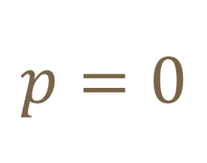
Scaling Method
$$p=0$$
1
7
11
1
(4,4) → 0, 0
0
2
(4,6) → 0, 0
(7,28) → 0, 0
0
(7,2) → 0, 0
3
1
(2,20) → 0, 0
(5,25) → 6, 0
(1,16) → 0, 0
(1,4) → 0, 0
4
(6,20) → 0, 0
-1
(2,11) → 0, 0
-1
5
(2,14) → 0
12
12
Notes:
Continuing further, we set p to 0 and f to 2f. We recalculate the capacities, obtain a new network, calculate the shortest path, and start sending flow based on the shortest path.

Slide 33
Scaling Method
$$p=0$$
1
7
11
0
(4,3) → 0, 0
0
2
(4,7) → 0, 0
(7,28) → 0, 0
0
(7,2) → 0, 0
3
1
(2,20) → 0, 0
(5,25) → 6, 0
(1,15) → 0, 0
(1,5) → 0, 0
4
(6,20) → 0, 0
-1
(2,11) → 0, 0
0
5
(2,14) → 0
12
12
Notes:
And push the flow again.

Slide 34
Scaling Method
$$p=0$$
1
7
11
0
(4,2) → 0, 0
0
2
(4,8) → 0, 0
(7,27) → 0, 0
0
(7,3) → 0, 0
3
0
(2,20) → 0, 0
(5,25) → 6, 0
(1,14) → 0, 0
(1,6) → 0, 0
4
(6,20) → 0, 0
0
(2,12) → 0, 0
0
5
(2,13) → 0
12
12
Notes:
At this stage, all supplies and demands are satisfied without violating the constraints of the dual problem, indicating an optimal solution.

Slide 35
Scaling Method
1
7
11
5
(4,8) → 0
-2
2
3 → 0
0
3
23
0 → 1
0 → 2
6 → 0
4
20 → -4
-7
13 → 0
-19
5
10
12
Notes:
The results obtained through the Scaling Method are identical to those of the Labeling Method.

Slide 36
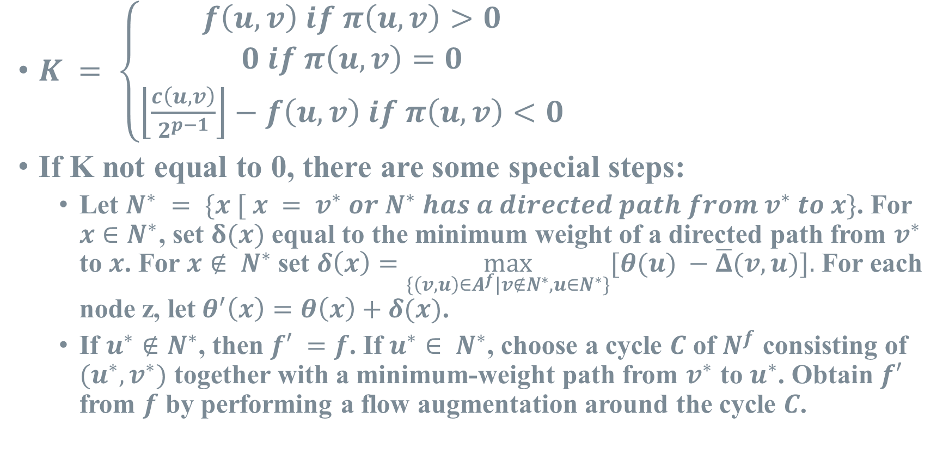
Note of Scaling Method
$K = \left\{\begin{aligned}f\left(u, v\right) if π\left(u, v\right)>0 \\ 0 if π\left(u, v\right)=0 \\ \left\lfloor \frac{c\left(u, v\right)}{2^{p−1}}\right\rfloor −f\left(u, v\right) if π\left(u, v\right)<0\end{aligned}\right.$
If K not equal to 0, there are some special steps:
Let $N^{∗} = \{x [ x = v^{∗} or N^{∗} has a directed path from v^{∗} to x\}$. For $x∈N^{∗}$, set $δ(x)$ equal to the minimum weight of a directed path from $v^{∗}$ to $x$. For $x∉ N^{∗}$set $δ\left(x\right)=\max_{\{\left(v,u\right)∈A^{f}|v∉N^{∗}, u∈N^{∗}\}}[θ(u) −\overline{Δ}(v, u)].$ For each node z, let${ θ}^{′}\left(x\right)=θ\left(x\right)+δ(x)$.
If $u^{∗}∉N^{∗}$, then $f′ =f$. If $u^{∗}∈ N^{∗}$, choose a cycle $C$ of $N^{f}$ consisting of $(u^{∗}, v^{∗})$ together with a minimum-weight path from $v^{∗}$ to $u^{∗}$. Obtain $f′$ from $f$ by performing a flow augmentation around the cycle $C$.
Notes:
Earlier, I mentioned the need for a check, which is represented by K. The definition of K is shown here. If the reduce cost of an arc is positive, then K equals f(u, v) because we want arcs with positive reduce cost to have no flow. If the reduce cost is 0, then K equals 0 because any flow value is valid since it cannot exceed the upper bound. If the reduce cost is negative, then K equals the difference between f(u, v) and the upper bound because we want arcs with negative reduce cost to maximize flow. If K is not equal to 0, we need to update the reduce cost and adjust the flow accordingly.

Slide 37
Note of Scaling Method
0
(7,5)
(5,5)
8
(100,10)
-8
(6,5)
(2,5)
0
Notes:
Here's an example of a network to illustrate this concept.

Slide 38
Note of Scaling Method
$$p=3$$
0
0
(7,0) → 7
(5,0) → -95
0
100
1
(100,1) → 0
-1
(6,0) → 6
(2,0) → -98
0
0
Notes:
We find the shortest path as before and proceed to push the flow.

Slide 39
Note of Scaling Method
$$p=3$$
0
0
(7,0) → 7
(5,0) → -95
0
100
1
(100,1) → 0
-1
(6,0) → 6
(2,0) → -98
0
0
Notes:
After completing the flow push, the stage for p = 3 is finished.

Slide 40
Note of Scaling Method
$$p=2$$
7
0
(7,1) → 0, 0
(5,1) → 4, 0
0
8
2
(100,2) → 92, 2
-2
(6,1) → 0, 0
(2,1) → 0, 0
0
6
Notes:
Next, with p = 2 and f = 2f, it is clear that this is not the optimal solution. Since the reduce cost of the middle arc is > 0 and the flow is > 0, according to the definition, K equals the flow, which is 2. First, we try to find the shortest path starting from v, but all reachable nodes have a flow value of 0. Then, we find a path from v to u, and using this loop, we push the flow backward by 1 unit.

Slide 41
Note of Scaling Method
$$p=2$$
7
0
(7,1) → 0, 0
(5,1) → 4, 0
0
8
v
(100,2) → 92, 2
u
(6,1) → 0, 0
(2,1) → 0, 0
0
6
Notes:
After this update, K decrease by one.

Slide 42
Note of Scaling Method
$$p=2$$
7
0
(7,1) → 0, 0
(5,1) → 0, 0
0
12
v
(100,1) → 92, 1
u
(100,1) → 92, 1
(-6,1) → 0, 0
(-2,1) → -4, 0
0
6
Notes:
We repeat the process again.

Slide 43
Note of Scaling Method
$$p=2$$
7
0
(7,1) → 0, 0
(5,1) → 0, 0
0
12
v
(100,1) → 92, 1
u
(100,1) → 92, 1
(-6,1) → 0, 0
(-2,1) → -4, 0
0
6
Notes:
We get another cycle and push flow backward again.

Slide 44
Note of Scaling Method
$$p=2$$
7
0
(-7,1) → 0, 0
(-5,1) → 0, 0
0
12
0
(100,2) → 92, 0
0
(-6,1) → 0, 0
(-2,1) → -4, 0
0
6
Notes:
Now K is equal to 0, indicating the optimal solution for p = 2.

Slide 45
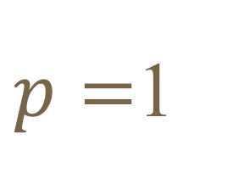
Note of Scaling Method
$p=$1
7
0
(-7,2) → 0, 0
(-5,2) → 0, 0
0
12
0
(100,2) → 92, 0
0
(-6,2) → 0, 0
(-2,2) → -4, 0
0
6
Notes:
In this example, when p = 1, simply setting f = 2f leads to the optimal solution.

Slide 46
Note of Scaling Method
$$p=0$$
7
0
(-7,4) → 0, 0
(-5,4) → 0, 0
0
(7,1) → 0, 0
(5,1) → 0, 0
12
0
(100,2) → 92, 0
0
(-6,4) → 0, 0
(2,1) → -4, 0
(6,1) → 0, 0
(-2,4) → -4, 0
0
6
Notes:
The same applies when p = 0.

Slide 47
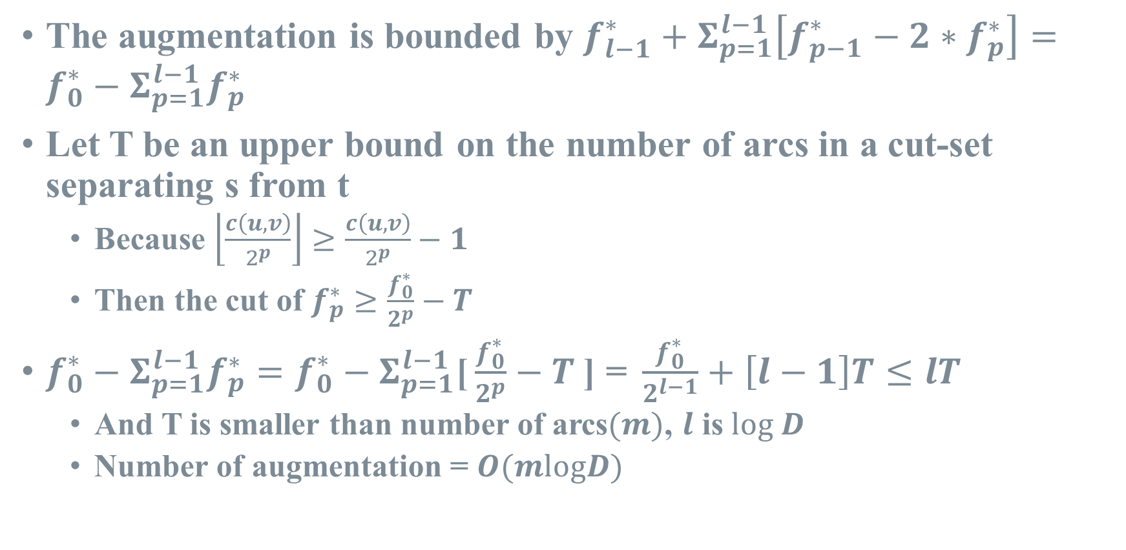
Complexity of Scaling Method
The augmentation is bounded by $f_{l−1}^{∗}+Σ_{p=1}^{l−1}\left[f_{p−1}^{∗}−2∗f_{p}^{∗}\right]=f_{0}^{∗}−Σ_{p=1}^{l−1}f_{p}^{∗}$
Let T be an upper bound on the number of arcs in a cut-set separating s from t
Because $\left\lfloor \frac{c\left(u, v\right)}{2^{p}}\right\rfloor ≥\frac{c\left(u, v\right)}{2^{p}}−1$
Then the cut of $f_{p}^{∗}≥\frac{f_{0}^{∗}}{2^{p}}−T$
$f_{0}^{∗}−Σ_{p=1}^{l−1}f_{p}^{∗}=f_{0}^{∗}−Σ_{p=1}^{l−1}\text{[}\frac{f_{0}^{∗}}{2^{p}}−T \text{]}\text{ = }\frac{f_{0}^{∗}}{2^{l−1}}+\left[l−1\right]T≤lT$
And T is smaller than number of arcs$(m)$, $l$ is $log D$
Number of augmentation = $O(mlogD)$
Notes:
Finally, let's analyze the complexity of this algorithm. The time complexity part is my own deduction. The maximum number of augmentations is bounded by the initial solution plus the difference between the optimal solutions of each network and twice the optimal solution of the previous network. Thus, we have fp ≥ f0 / 2^p - T, where T is the number of arcs in the cut. Since this mathematical inequality always holds, we can derive this equation, and this part is less than T, so the total number of augmentations is less than lT, which is O(mlogD).

Slide 48
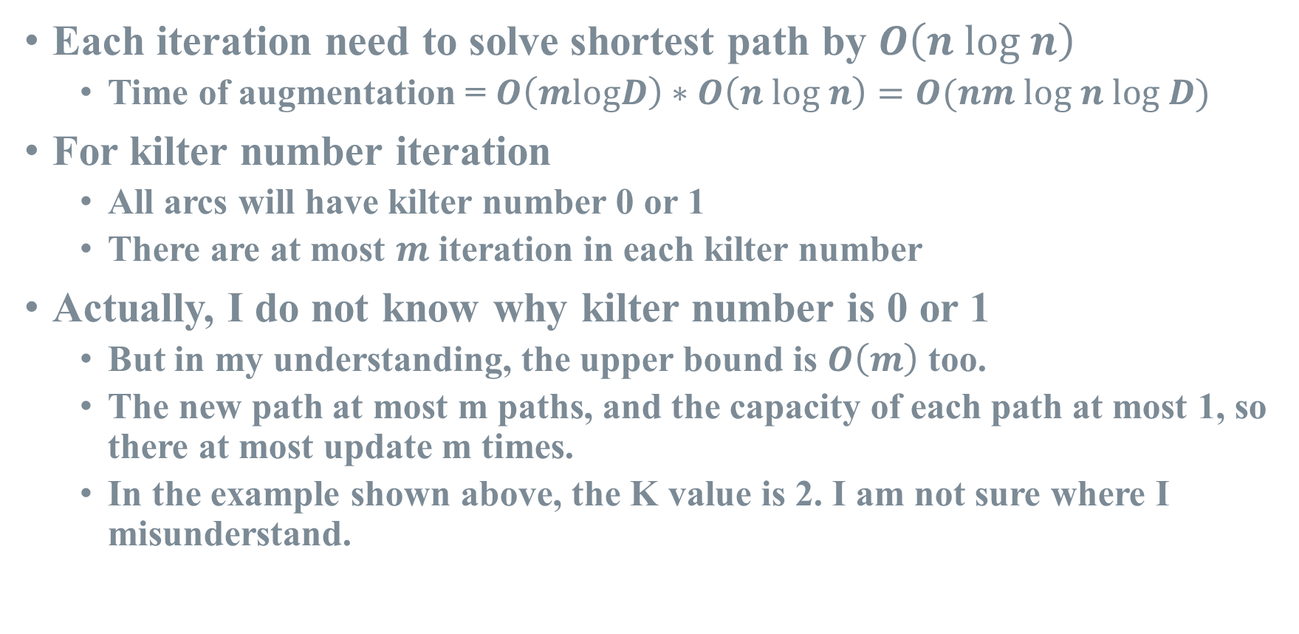
Complexity of Scaling Method
Each iteration need to solve shortest path by $O\left(n log n\right)$
Time of augmentation = $O\left(mlogD\right)∗O\left(n log n\right)=O(nm log n log D)$
For kilter number iteration
All arcs will have kilter number 0 or 1
There are at most $m$ iteration in each kilter number
Actually, I do not know why kilter number is 0 or 1
But in my understanding, the upper bound is $O\left(m\right)$ too.
The new path at most m paths, and the capacity of each path at most 1, so there at most update m times.
In the example shown above, the K value is 2. I am not sure where I misunderstand.
Notes:
With a maximum of O(mlogD) augmentations, the worst-case scenario is when each augmentation requires executing Dijkstra's algorithm, which takes O(n log n) time.

Slide 49
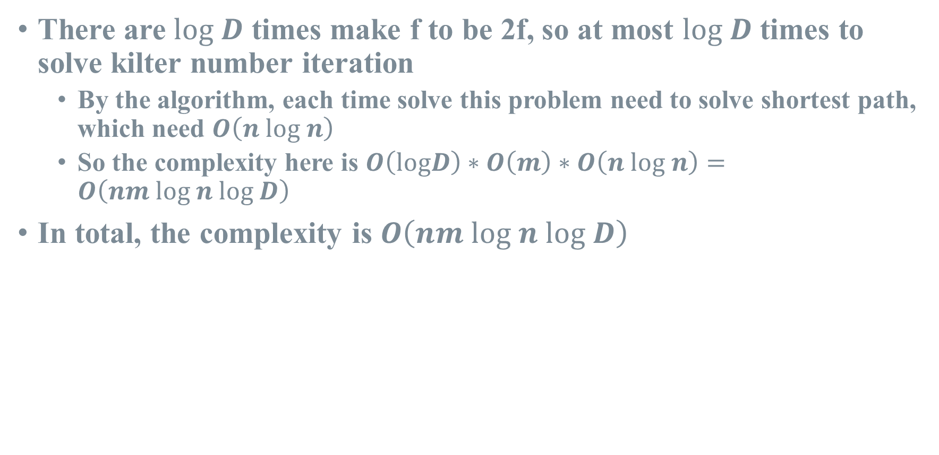
Complexity of Scaling Method
There are $log D$ times make f to be 2f, so at most $log D$ times to solve kilter number iteration
By the algorithm, each time solve this problem need to solve shortest path, which need $O\left(n log n\right)$
So the complexity here is $O\left(logD\right)∗O\left(m\right)∗O\left(n log n\right)=O\left(nm log n log D\right)$
In total, the complexity is $O\left(nm log n log D\right)$
Notes:
Regarding the kilter number, the paper states that it is either 0 or 1, but I'm unsure about how this is determined. In my own example, K is 2. However, there can be at most m paths that correct K, and each correction contributes at least 1, so the maximum number of executions is O(m). In conclusion, the overall time complexity is O(nm log n log D), which is consistent with the augmentation time complexity.

Slide 50
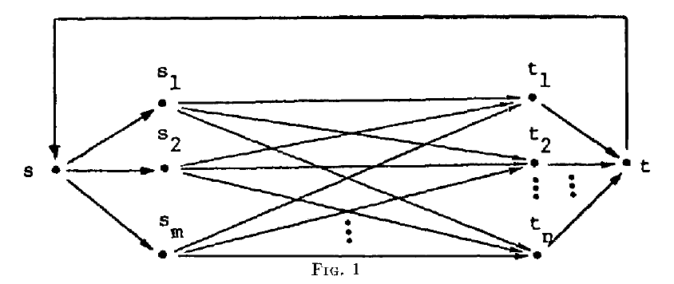
Special Case of Scaling Method
1
2
3
4
Hitchcock problem
5
Notes:
Lastly, this figure is from section 2.2 of the paper. It states that the aforementioned algorithm can yield pseudo-extreme solutions without considering K, and pseudo-extreme solutions are sufficiently good. The complexity remains relatively unchanged.

Slide 51
Thanks for Listening
JACK EDMONDS & RICHARD M. KARP in 1972
Professor: Doctor I-Lin Wang
Student: Yi-Cheng Ke
Notes:
This concludes my presentation, and thank you for listening.

